Slide 1
Time Series Data Mining Review
Author: Sun Zhao
Email:zixiaojindao@gmail.com

Slide 2
Sequence Analysis
Subsequence Matching
Frequent subsequence mining
Sequence Prediction
Bioinformatics Sequence Analysis
DNA sequence alignment
Motif discovery
Sequence classification

Slide 3
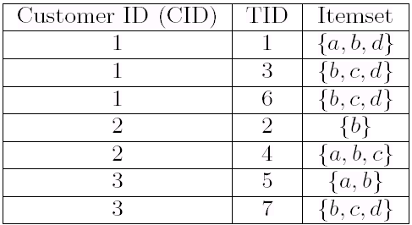
Frequent subsequence mining
Sequence
representation
S= ({a}, {b, c}) is a sequence
The support of S is Sup_{D}(S)
Frequent sequential pattern:
Sup_{D}(S) >= Min Support
Sup_{D}(S) = Sup_{D} ({a}, {b, c} ) = 2

Slide 4
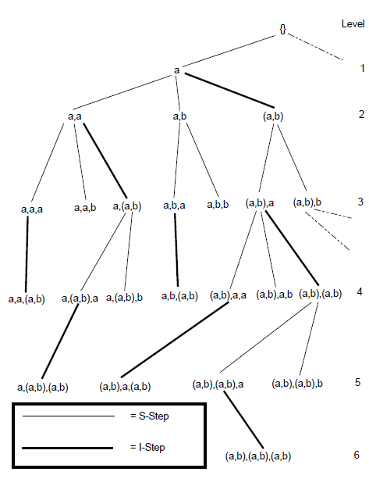
Sequence Tree
S = ({a, b, c}, {a, b})
Sequence-extended sequence
S’=({a,b,c},{a,b},{d})
Item-extended sequence
S’=({a,b,c},{a,b,d}

Slide 5
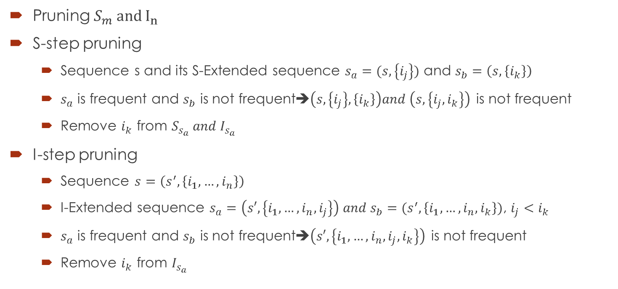
Frequent subsequence mining
Pruning $S_{m} and I_{n}$
S-step pruning
Sequence s and its S-Extended sequence $s_{a}=(s,\left\{i_{j}\right\})$ and $s_{b}=\left(s,\left\{i_{k}\right\}\right)$
$s_{a}$ is frequent and $s_{b}$ is not frequent➔$\left(s,\left\{i_{j}\right\},\left\{i_{k}\right\}\right)and \left(s,\left\{i_{j}, i_{k}\right\}\right)$ is not frequent
Remove $i_{k}$ from $S_{s_{a}} and I_{s_{a}}$
I-step pruning
Sequence $s=\left(s^{′},\left\{i_{1},…,i_{n}\right\}\right)$
I-Extended sequence $s_{a}=\left(s′,\left\{i_{1},…,i_{n},i_{j}\right\}\right) and s_{b}=(s^{′},\left\{i_{1},…,i_{n},i_{k}\right\})$, $i_{j}<i_{k}$
$s_{a}$ is frequent and $s_{b}$ is not frequent➔$\left(s′,\left\{i_{1},…,i_{n},i_{j},i_{k}\right\}\right)$ is not frequent
Remove $i_{k}$ from $I_{s_{a}}$

Slide 6
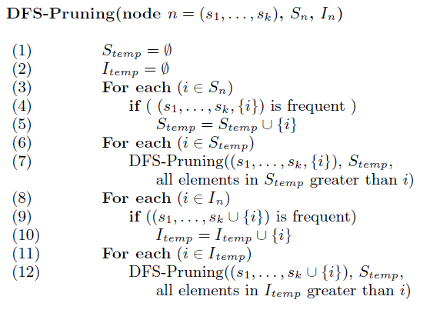
DFS-Pruning Algorithm
DFS-Pruning Algorithm

Slide 7
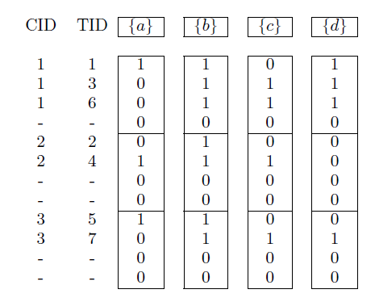

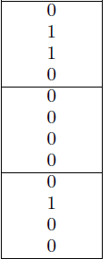
How to count frequency？
Sequence bitmap, last item set indicator

Slide 8
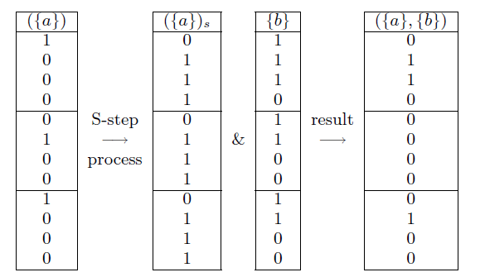
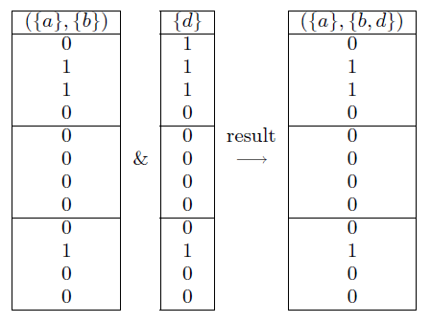
Bitmap Counting
S-Process I-Process

